Slide 1
MA-541 Project Presentation
Team pandas：
Hai Huang, Shaocheng Wang, Tianyi Li, Xiaoyi Leng, Yankai Zhao
2020/12/8

Slide 2
1
Describing Data
2
Data Analysis
3
Construct a confidence interval
CONTENTS
4
Form a hypothesis
5
Compare you data with a different data set
6
Fitting the line to the data
7
Does your model predict?
8
Checking residuals and model selection

Slide 3
01
Describing Data

Slide 4
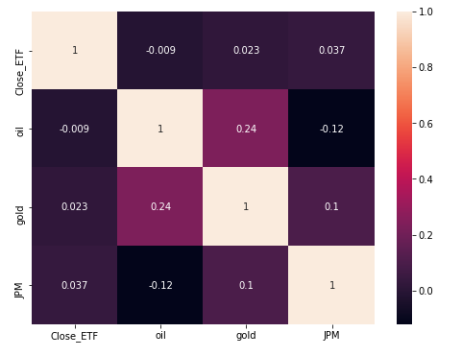
Describing Data
 | Mean | Std
ETF | 121.1530 | 12.5698
OIL | 0.0010 | 0.2109
GOLD | 0.0007 | 0.0113
JPM | 0.0005 | 0.0110

Slide 5
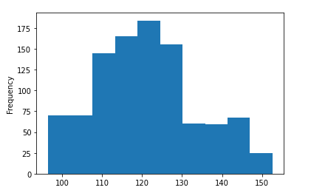
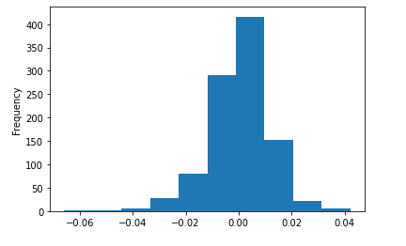
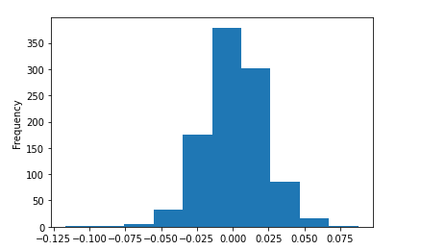
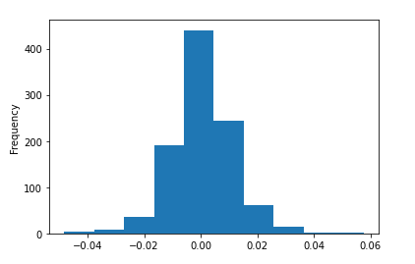
Describing Data
ETF
OIL
GOLD
JPM

Slide 6
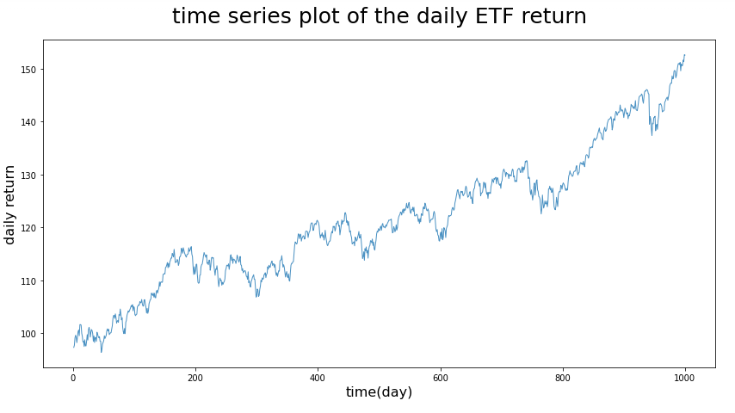
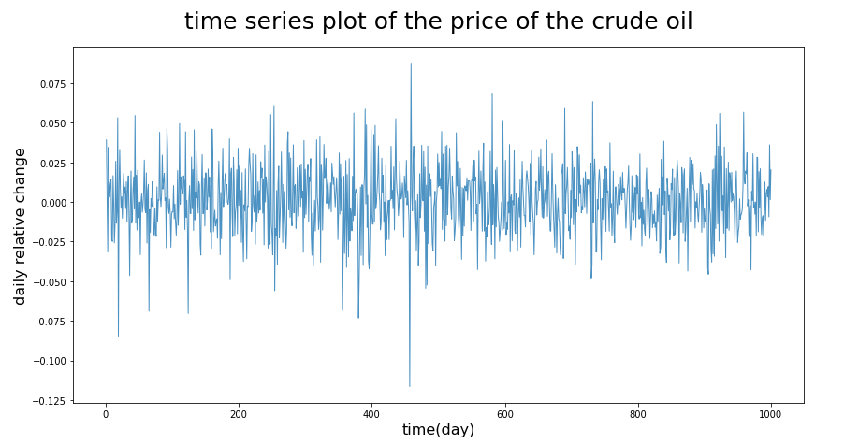
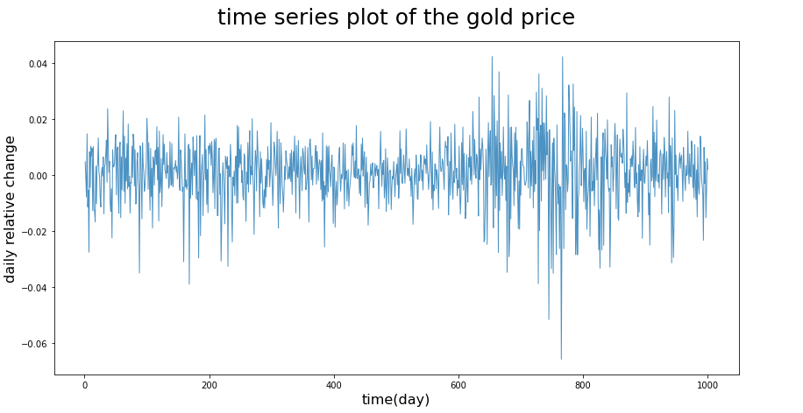
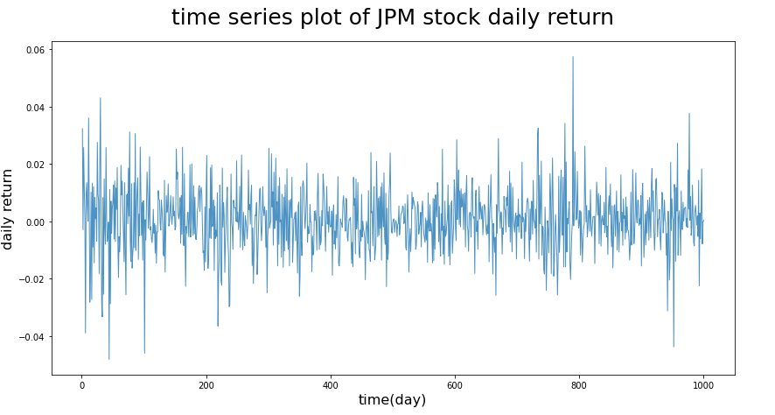
Describing Data

Slide 7
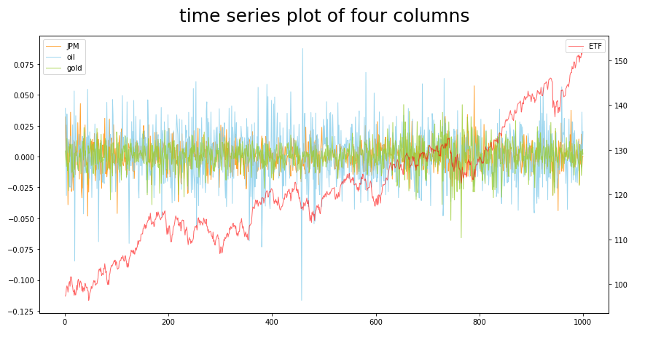
Describing Data

Slide 8
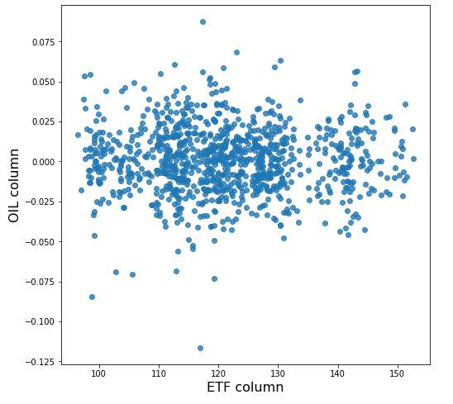
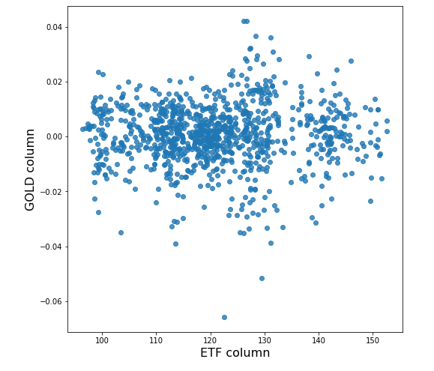
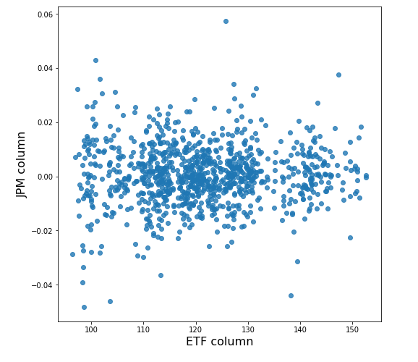
Describing Data

Slide 9
02
Data Analysis

Slide 10
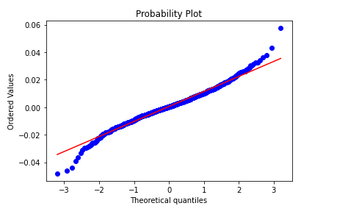
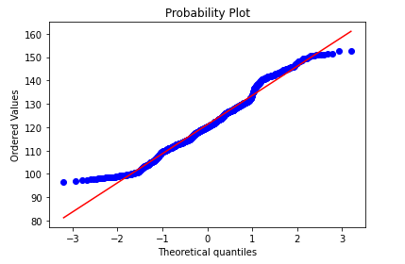
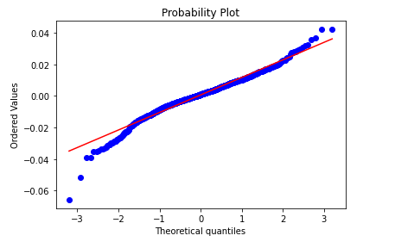
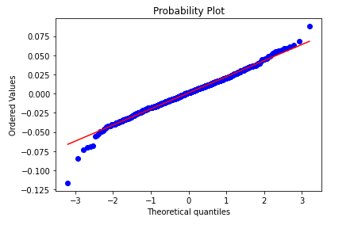
Data Analysis
ETF
JPM
We assume our data follows a normal distribution
OIL
GOLD

Slide 11
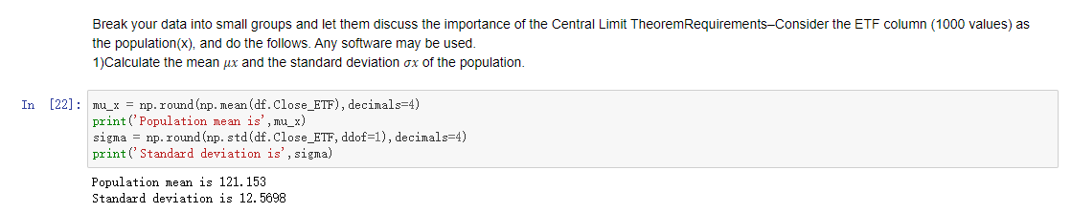
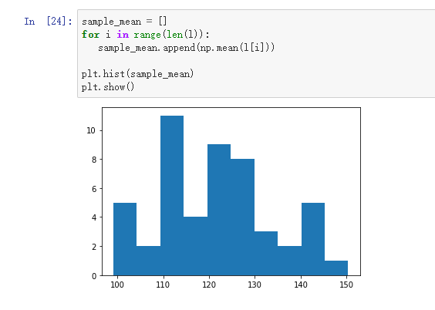
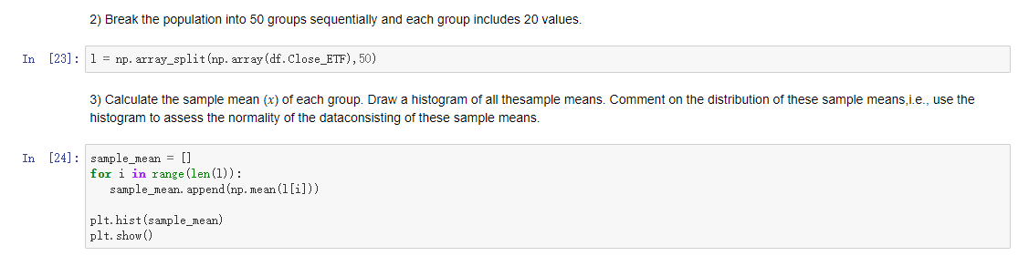
Data Analysis

Slide 12
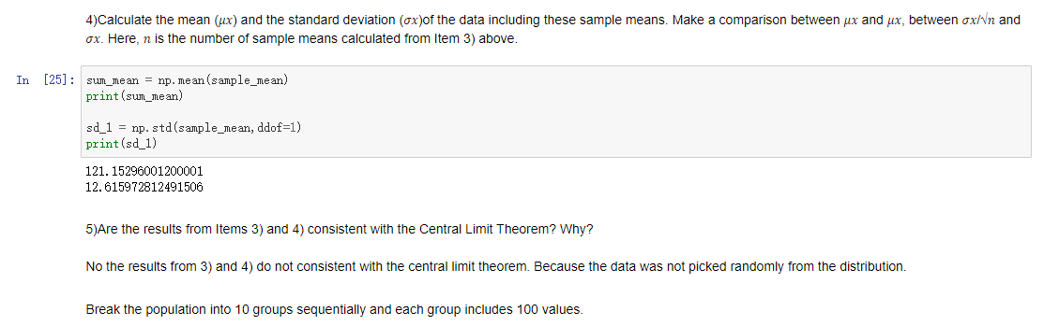
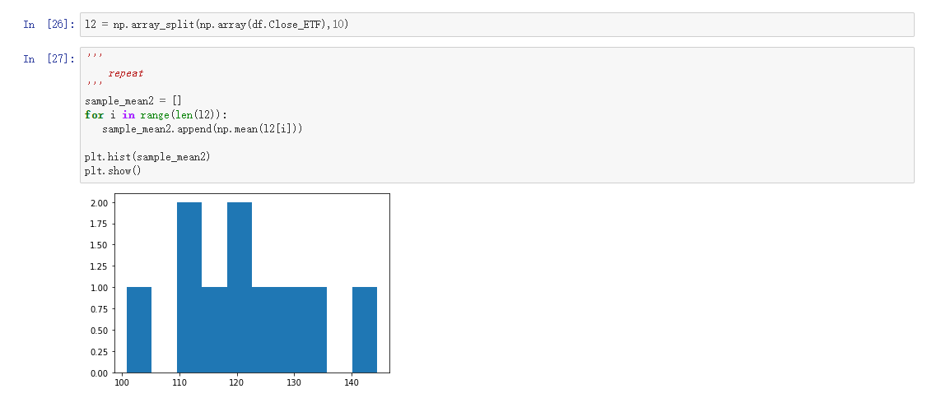
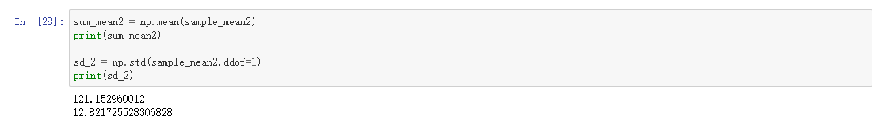
Data Analysis

Slide 13
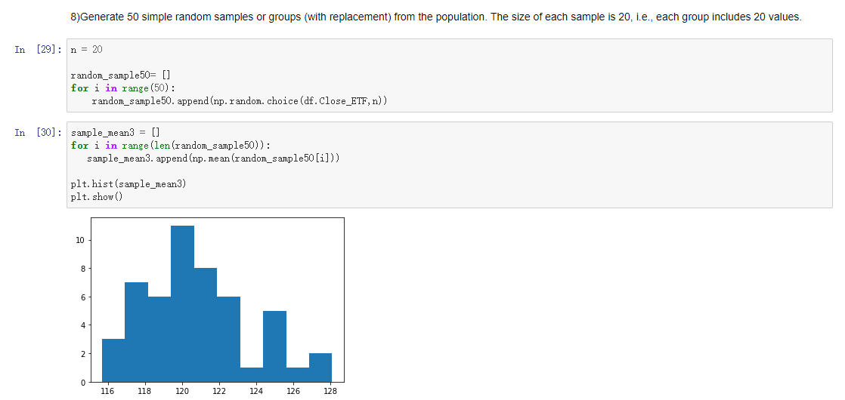
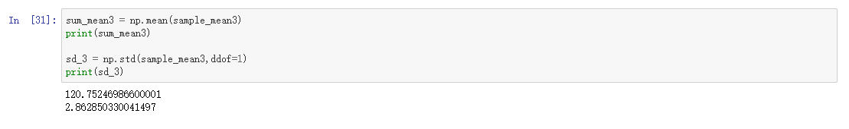
Data Analysis

Slide 14
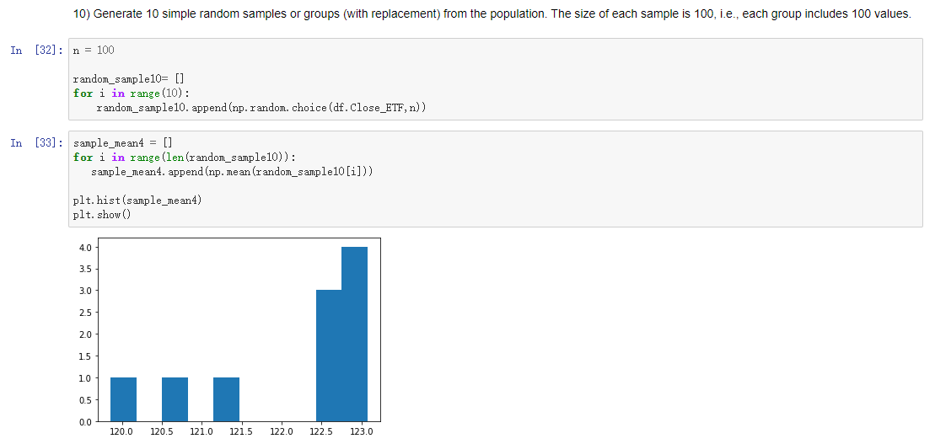
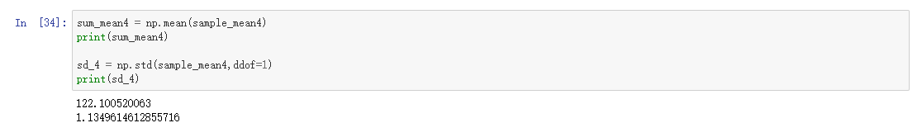
Data Analysis

Slide 15
03
Construct a confidence interval

Slide 16
Construct a confidence interval
 | 95% confidence interval
10 simple random samples | (98.16479624692182, 147.05780427307823)
50 simple random samples | (94.67787598874438, 144.24612291125564)
95% confidence interval (1) = (98.27123417560706, 146.9224883196801)
95% confidence interval (2) = (95.37512210637573, 143.7099206566719)
The second confidence interval is more accurate. Because the interval is smaller.

Slide 17
04
Form a hypothesis

Slide 18
Form a hypothesis
 | 𝑯𝟎: 𝝁 = 𝟏𝟎𝟎 vs. 𝑯𝒂: 𝝁 ≠ 𝟏𝟎𝟎 | 𝑯𝟎: 𝝈 = 𝟏𝟓 vs. 𝑯𝒂: 𝝈 ≠ 𝟏𝟓 | 𝑯𝟎: 𝝈 = 𝟏𝟓 vs. 𝑯𝒂: 𝝈 < 𝟏𝟓
10 simple random samples | Since p-value = 0.5311 which is larger than 0.05 we fail to reject null hypothesis.
50 simple random samples | Since p-value = 0.5466 which is larger than 0.05 we fail to reject null hypothesis. | Chi-square 1536.8749473112753 Chi-square value is greater than critical value, so the null hypothesis is rejected. | Chi-square 1536.8749473112753 chi-square value is greater than critical value, so the null hypothesis is rejected.

Slide 19
05
Compare you data with a different data set

Slide 20
Compare you data with a different data set
H0: means equal H1: means not equal
Since p-value = 0.6275 which is larger than 0.05 we fail to reject null hypothesis.
2) H0: means equal H1: means not equal
Since the p-value = 0.5884 is larger than 0.05 we do not reject the null hypothesis.
3) H0: equal standard deviation H1: not equal
Since the p-value = 7.906689618563355e-82 is less than 0.05 we reject null hypothesis.

Slide 21
06
Fitting the line to the data

Slide 22
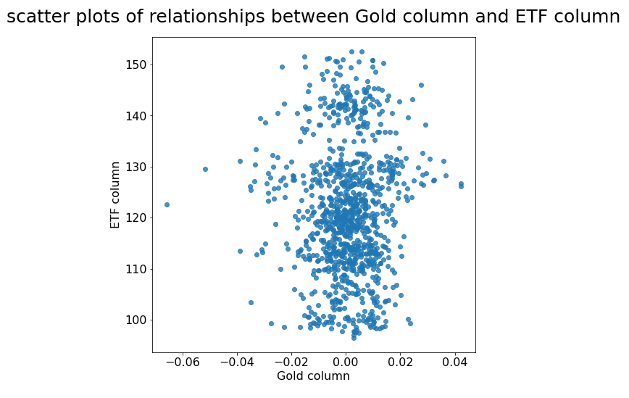
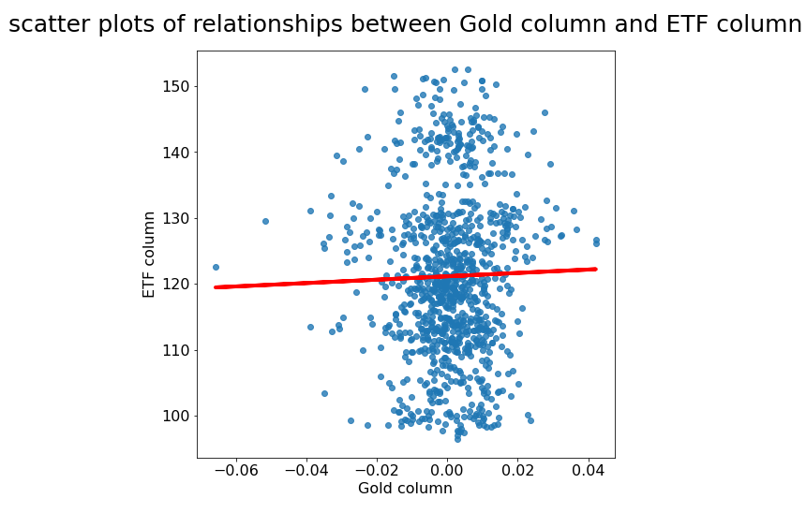
Fitting the line to the data
Fit a regression line
According to the plot, there is no linear relationship.
The value of the coefficient of determination is very small(0.022996), which means there is not much correlation between ETF and Gold.
intercept=121.135988;
slope=25.604389;
So, we can find the formula of regression line:
y = 121.135988 + 25.604389x

Slide 23
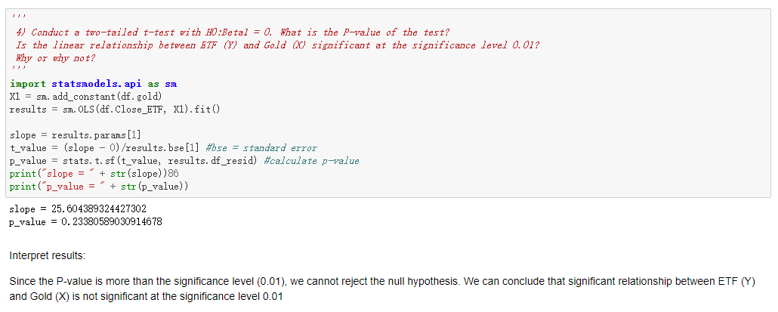
Fitting the line to the data

Slide 24
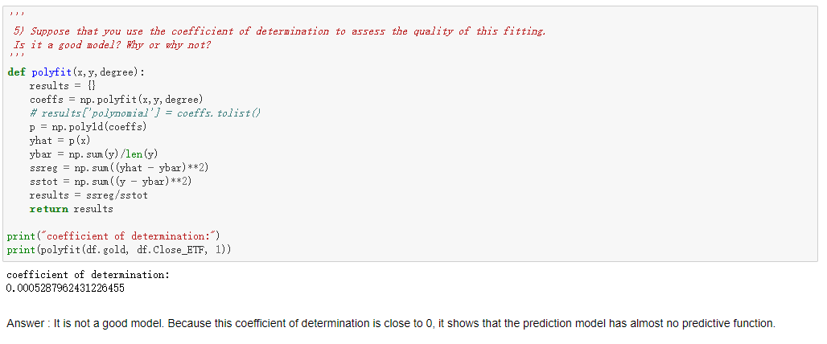
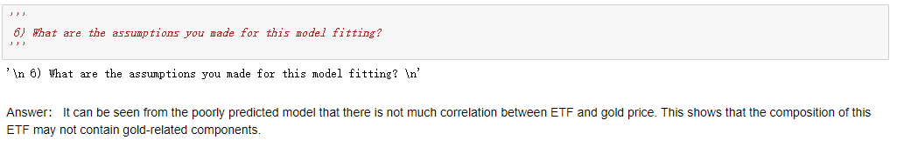
Fitting the line to the data

Slide 25
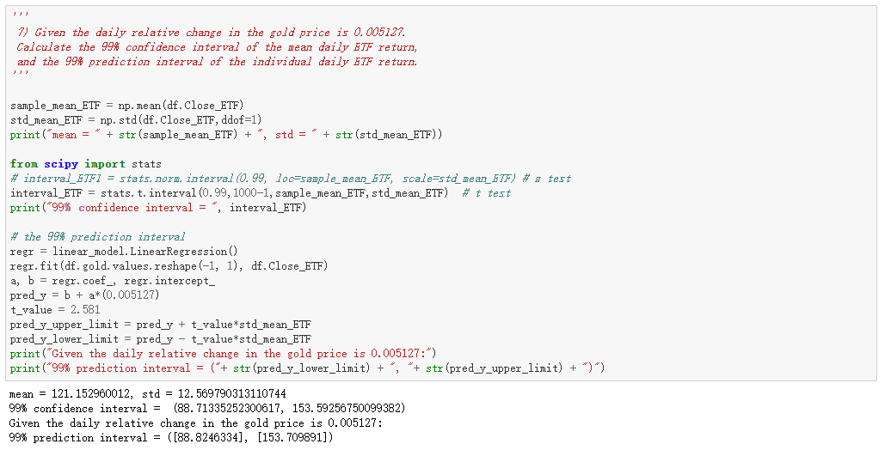
Fitting the line to the data

Slide 26
07
Does your model
predict

Slide 27
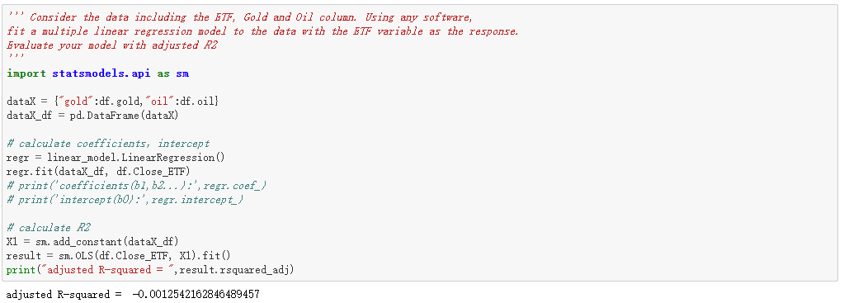
Does your model predict

Slide 28
08
Checking residuals and model selection

Slide 29
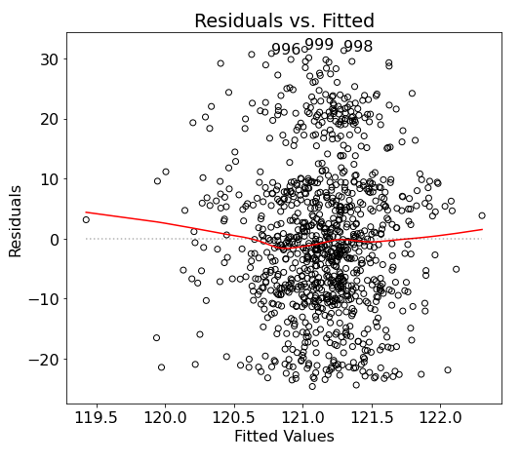
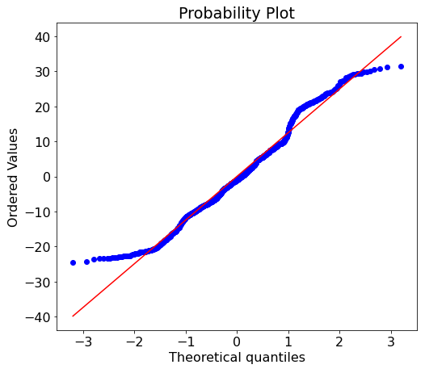
Checking residuals and model selection
From the Probability plot of the residuals we can see that the residuals follow normal distribution even with some outliers. Also from the residuals vs. fitted valued plots, most of the data gather between 121 and 121.5 fitted values at 0 of the residuals. So this may inform that the variance of the terms might not be equal. And since the residuals does bounce randomly around the 0 lines we can say that the relationship is linear. Also we are able to see there are outliers in the plots.
For model selection we can calculate AIC and BIC and use forward or backward stepwise to find the best features to use.

Slide 30
Thanks for
Listening
Team pandas
2020/12/8

